Slide 1
Software Engineering and Professional Practice. Building Usable Software. Unit 6: Software Project Management part 3:Project Risk Management
Anis Zarrad
a.zarrad@bham.ac.uk

Slide 2
Outlines
Project Risk Management
Risk Management Process

Slide 3
What is Risk?
A risk is an uncertain event which may occur in the future
A risk may prevent or delay the achievement of an organization’s or units objectives or goals
A risk is not certain – Its likelihood can only be estimated

Slide 4
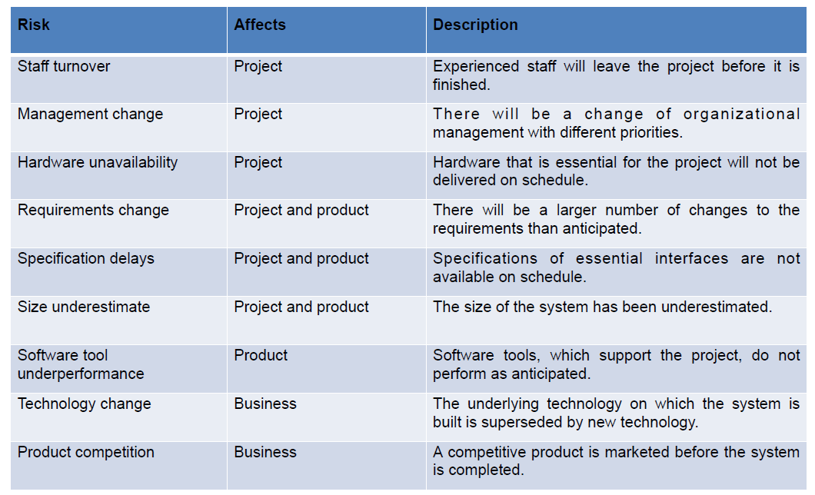
Examples of Common Risks

Slide 5
What is Risk Management?
It is a process to:
Identify all relevant risks
Assess / rank those risks
Address the risks in order of priority
Monitor risks & report on their management
Risk management is like a form of insurance; it is an investment

Slide 6
The Importance of Project Risk Management
It can help to improve project success
select good projects,
determining project scope,
developing realistic estimates
Promote good management
More then 55 % of runaway projects without a risk management plan

Slide 7
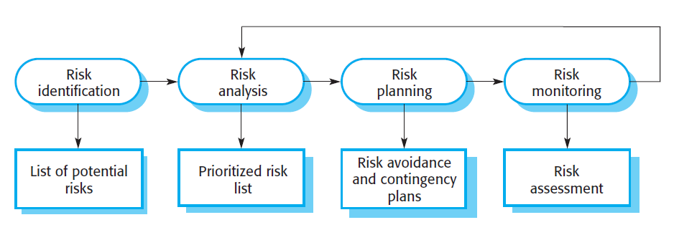
Risk Management Process

Slide 8
Risk Management Plan
The main output of risk management planning is a risk management plan
The project team should review project documents and understand the organization’s and the sponsor’s approach to risk
The level of detail will vary with the needs of the project and its complexity

Slide 9
Risk Identification
Risk identification the process of searching the environment, detecting risks, recognising their attributes, and estimating their consequences
Associated with your organization’s or units objectives?
Separate out the risk into its cause & possible effect
Be concise & clear
Common risks: estimation, organisational, people, requirements, technology, tools

Slide 10
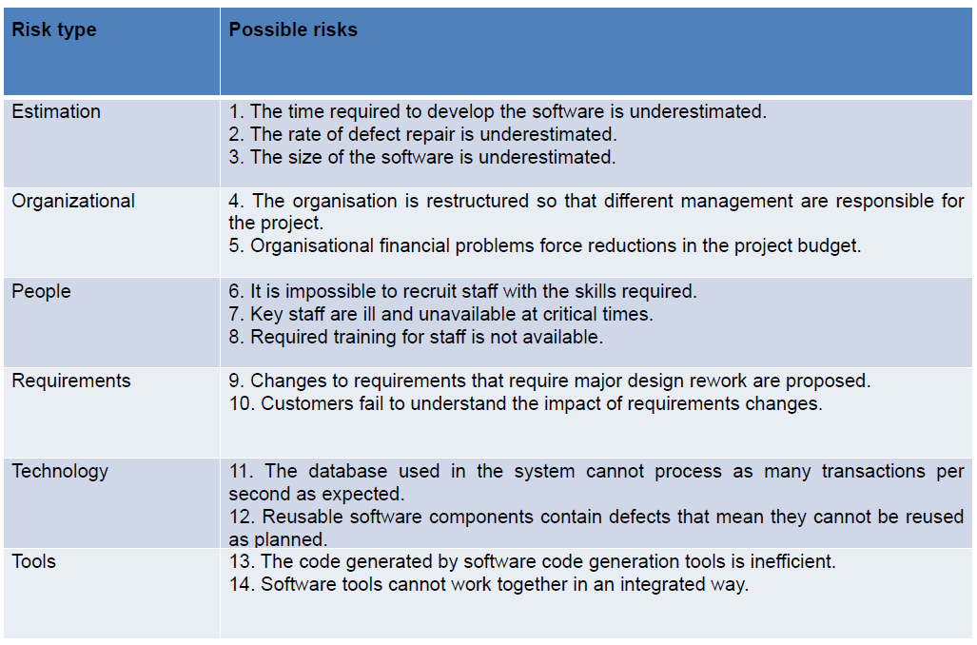
Examples of common risks

Slide 11
Risk Analyse / Prioritize
Assess probability and impact of identified risks
Probability may be insignificant, low, moderate, high or very high.
Consequences may be catastrophic, serious, tolerable or insignificant.
Risk quantification tools and techniques include
Probability/Impact matrixes
Expert judgment
Prioritize the risks
Hint: Get input from appropriate individuals

Slide 12
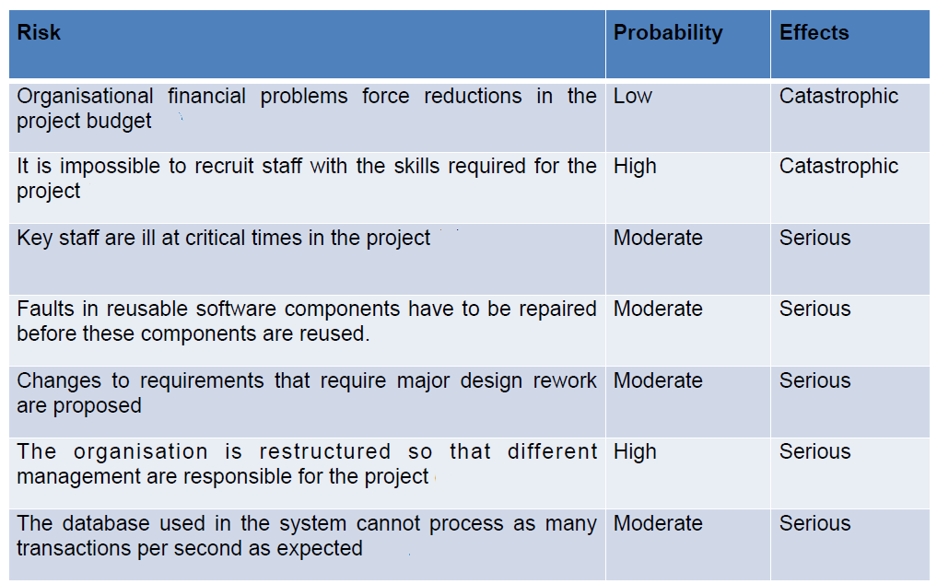
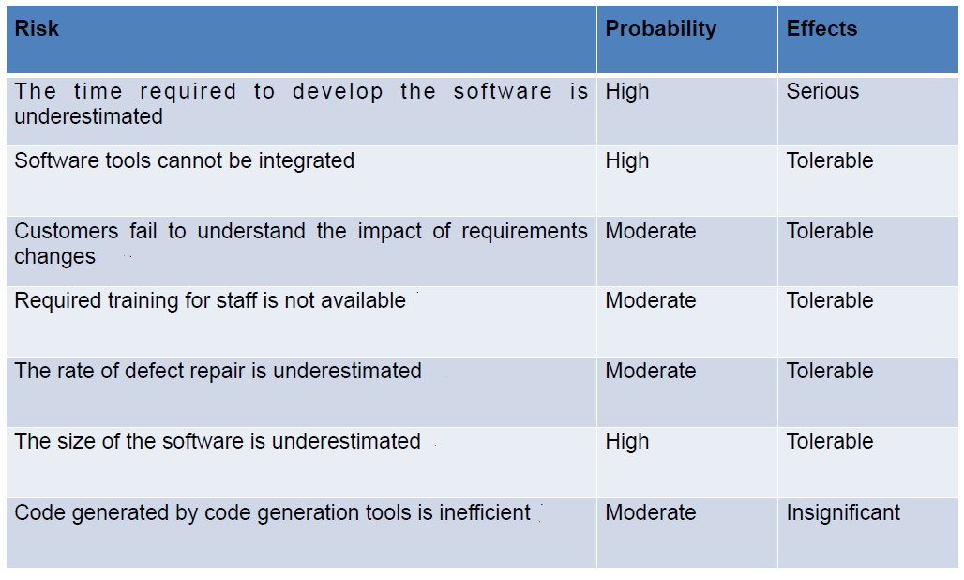
Example of risk analysis

Slide 13
Risk Response Planning
After identifying and quantifying risks, you must decide how to respond to them
Strategies:
Avoidance —-> the probability is reduced
Minimization —-> the impact is reduced
Contingency plan —-> preparing to deal with the risk

Slide 14
Example of risk management Strategies

Slide 15
Categories of Risk
Market risk: Will the new product be useful to the organization or marketable to others? Will users accept and use the product or service?
Financial risk: Can the organization afford to undertake the project?
Failure to safeguard assets
Poor budgeting
Operational risk: result from failed or inappropriate policies, procedures, systems or activities
Failure of an IT system
Poor quality of services delivered
Technology risk: Is the project technically feasible? Could the technology be obsolete before a useful product can be produced?

Slide 16
Why Risk Management May Fail
Limitations of scope
Lack of top management support
Did not engage all stakeholders
Failure to share information

Slide 17
Take Home Message
Risk management is a core part of all project management
Projects are novel and uncertain
Thank you

